Slide 1
2f. Feeder 04 Reduced OpenDSS Model

Slide 2
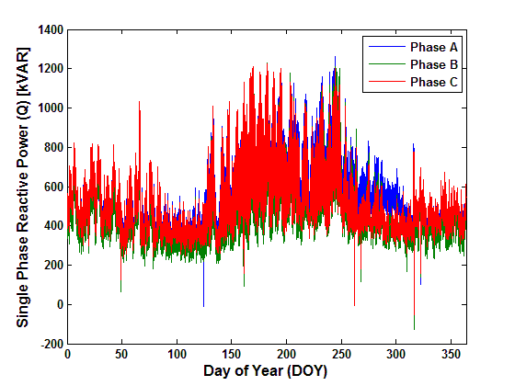
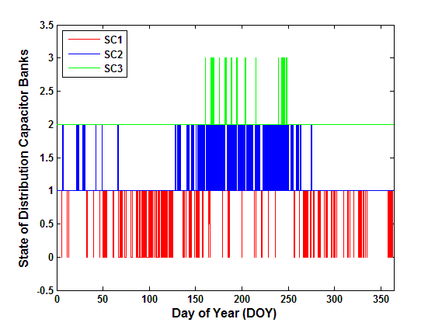
Capture of DSDR Operations on Feeder 04
The primary function of DSDR is to perform demand reduction at peak loading conditions by dropping OLTC and feeder SVR voltage set points system wide.
A 1% change in voltage results in a 0.2% to 1.5% change in real power and a 2% to 6% change in reactive power.
SC operations pulled from DSCADA historian. SC states stacked on top of one another with higher number out of pair signifying the “on” state.
(a) Derived Annual Q
(b) Historical S.C. States

Slide 3
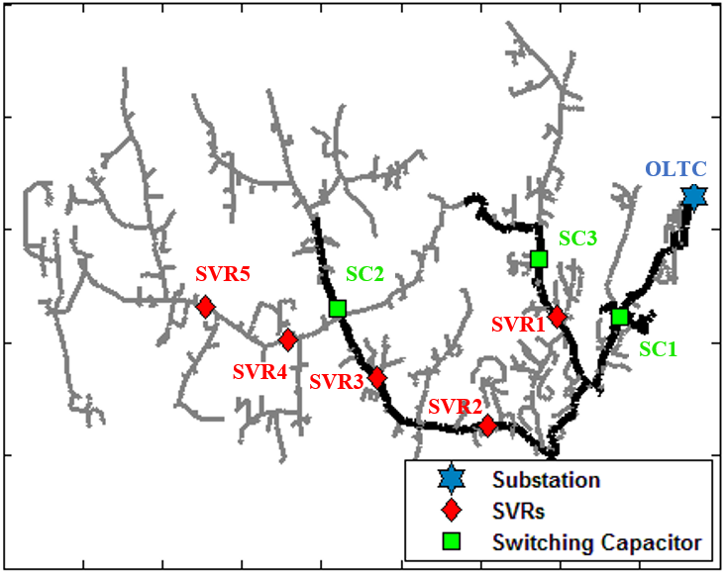
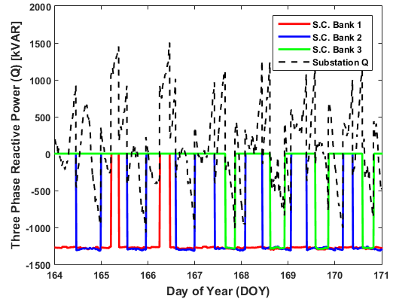
One Week QSTS Sim. Between DOY 164 to 171
It was concluded the DSDR program enforces a priority system in which the order goes SC1, SC2, and then SC3.
For example, if reactive power level was observed greater than threshold and only SC1 is energized, a command would be sent to SC2 to trip on-line for PF correction, therefore flattening the voltage profile and decreasing losses.
(a) Locations of V.R. Equipment
(b) States of S.C. Banks

Slide 4
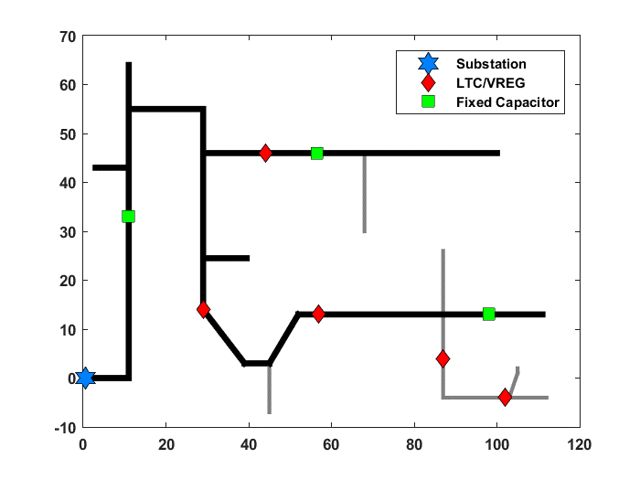
Simplifying the Feeder 04 Model
Topology Planning
Topology Results

Slide 5
Simplifying the Feeder 04 Model
Component Comparison
DSS Line/Bus Development
 | Detailed | Simplified | Reduction
Lines | 2196 | 67 | 96.9%
Loads | 1047 | 78 | 92.6%
Example DSS Line/Bus Development
New Line.K1 Phases=3 Bus1=08_1.1.2.3 Bus2=08_A1.1.2.3
~ Length=2833.6 units=ft Spacing=PEC_PEC_23kV_TRIA_3P
~ wires=['PEC_#2AWG_ACSR' 'PEC_#2AWG_ACSR' 'PEC_#2AWG_ACSR' 'PEC_#2AWG_ACSR']

Slide 6
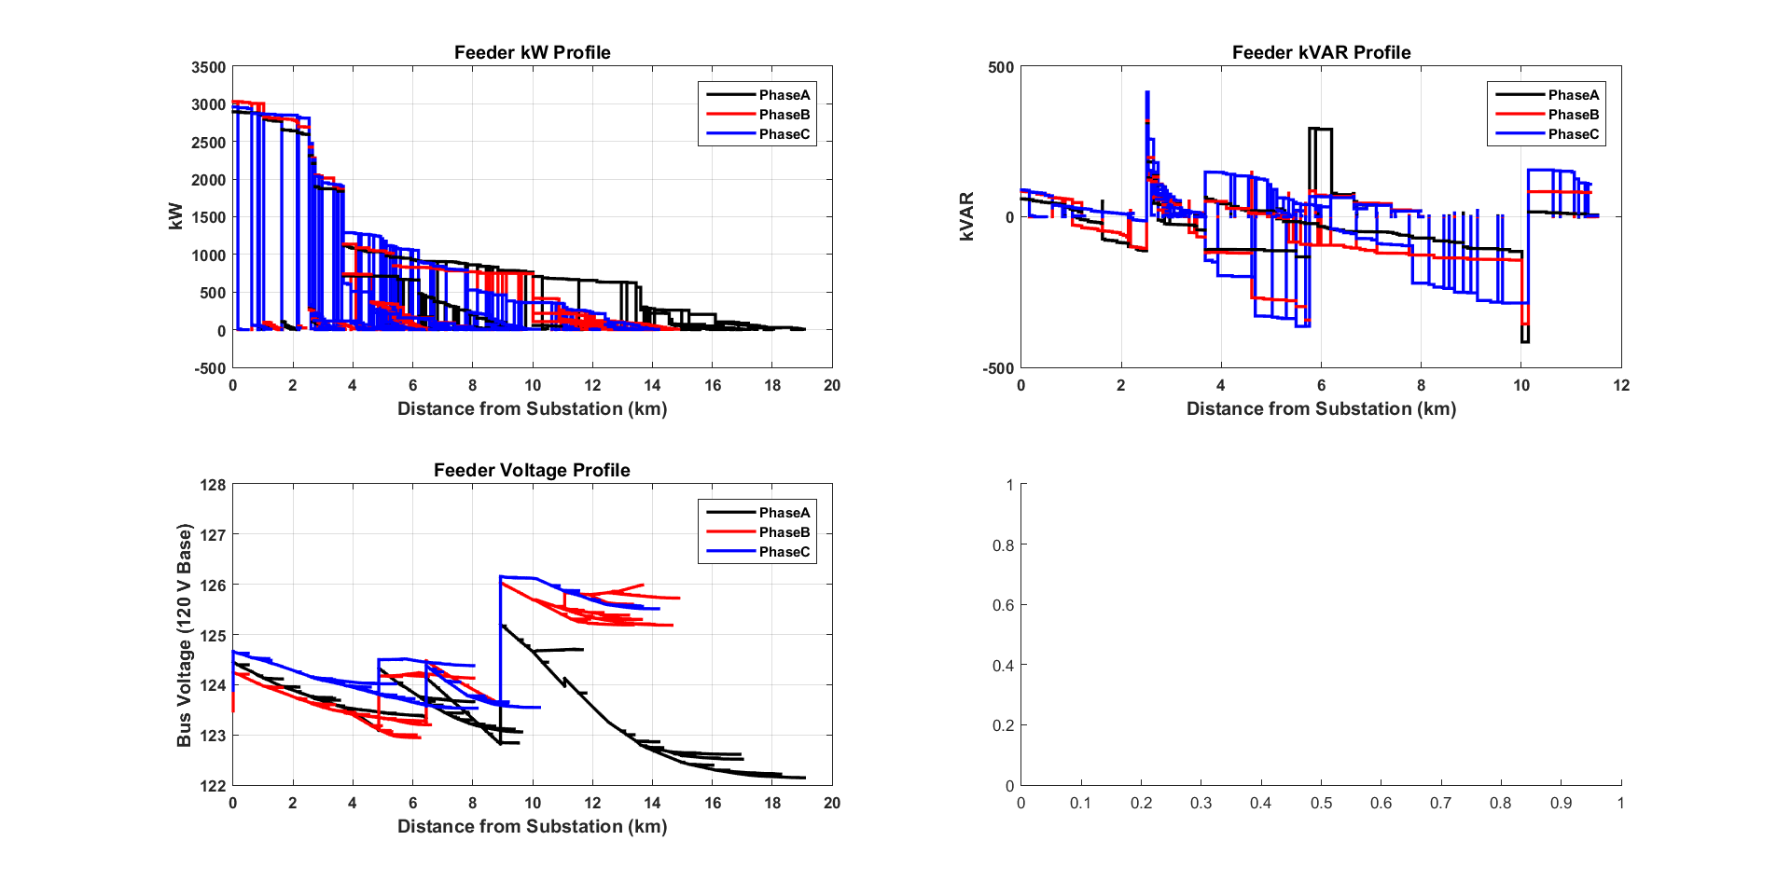
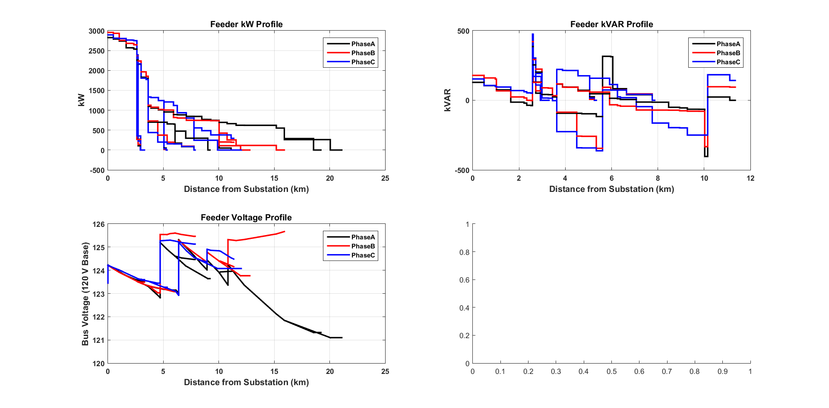
Static Power Flow
Detailed
Simplified

Slide 7
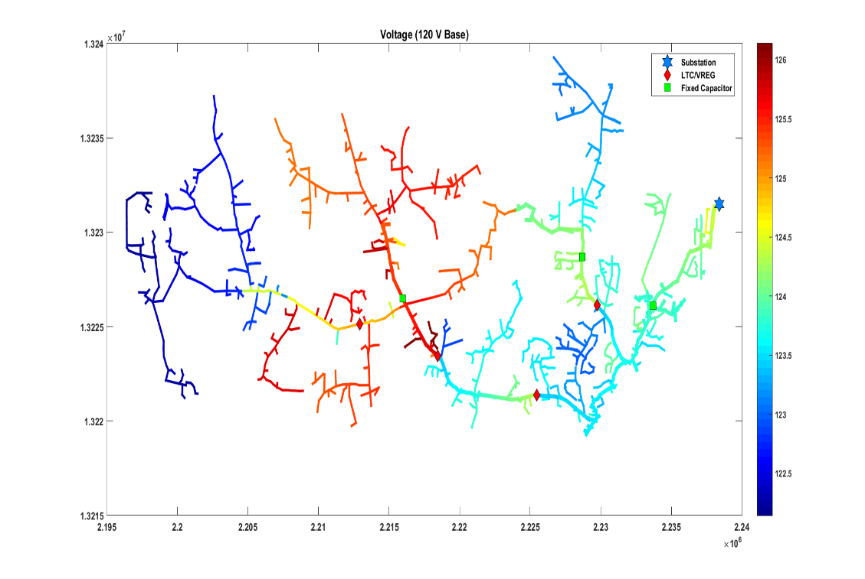
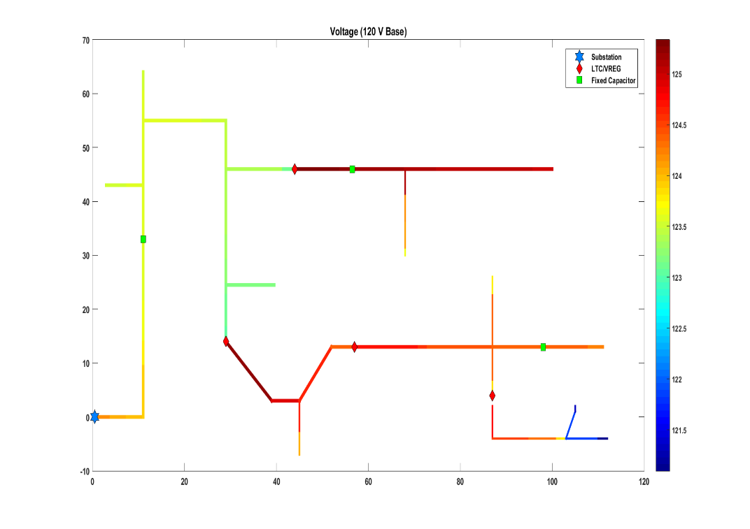
Static Power Flow
Detailed
Simplified

Slide 8
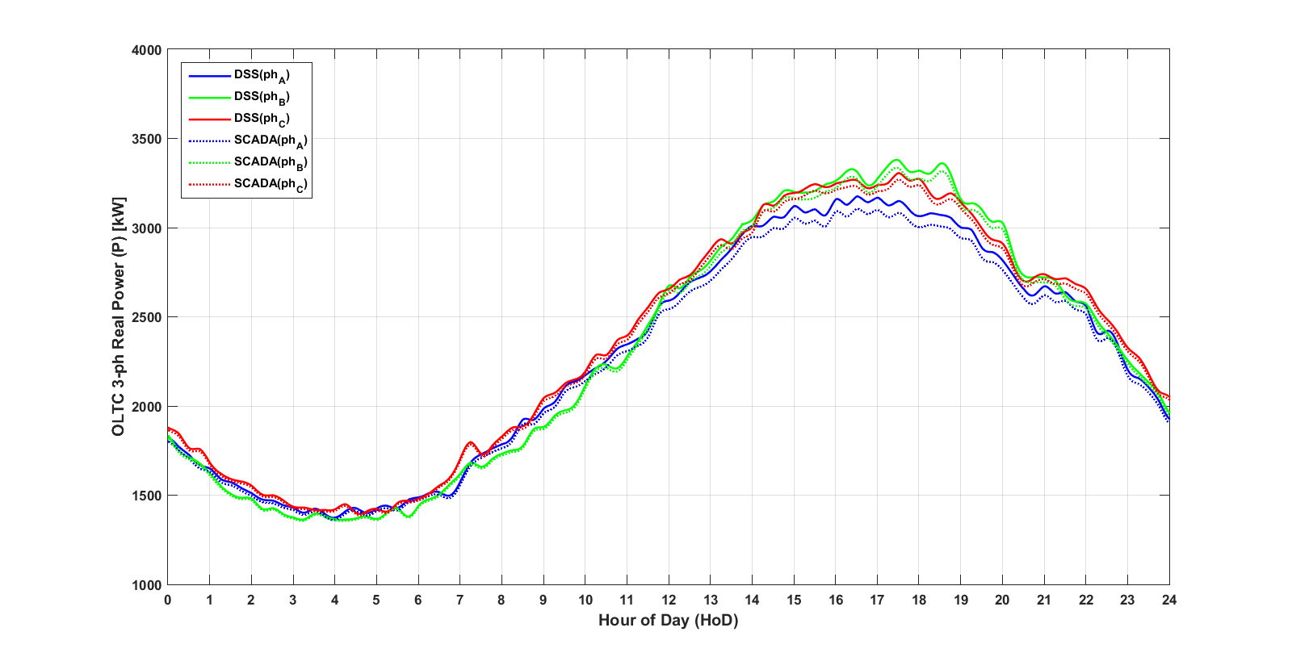
24 Hour QSTS kW

Slide 9
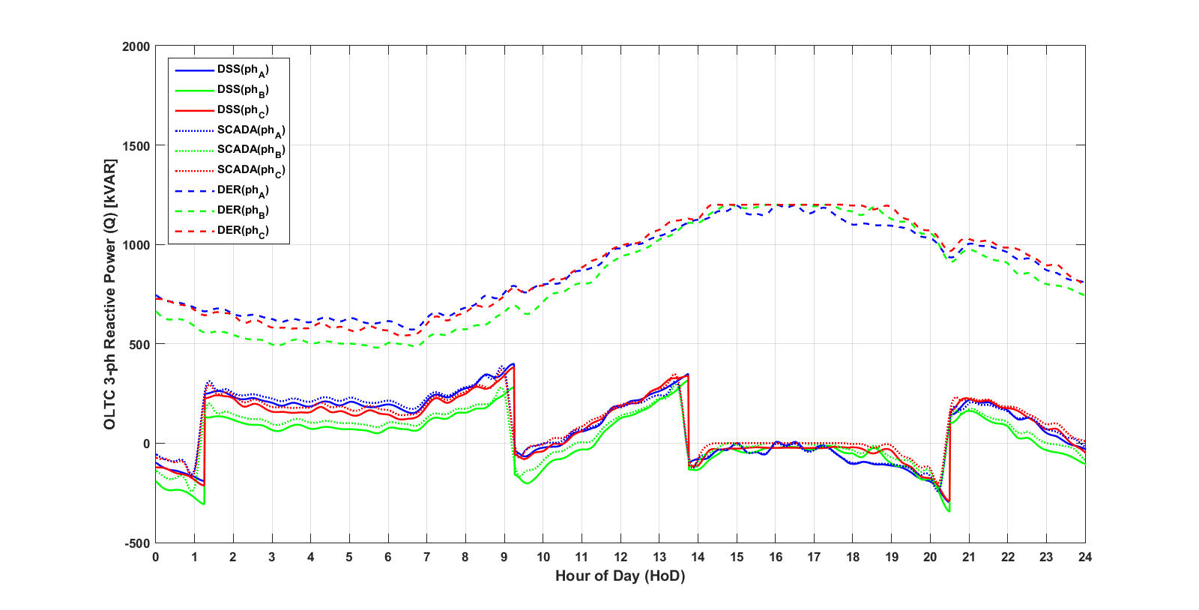
24 Hour QSTS kVAR

Slide 10
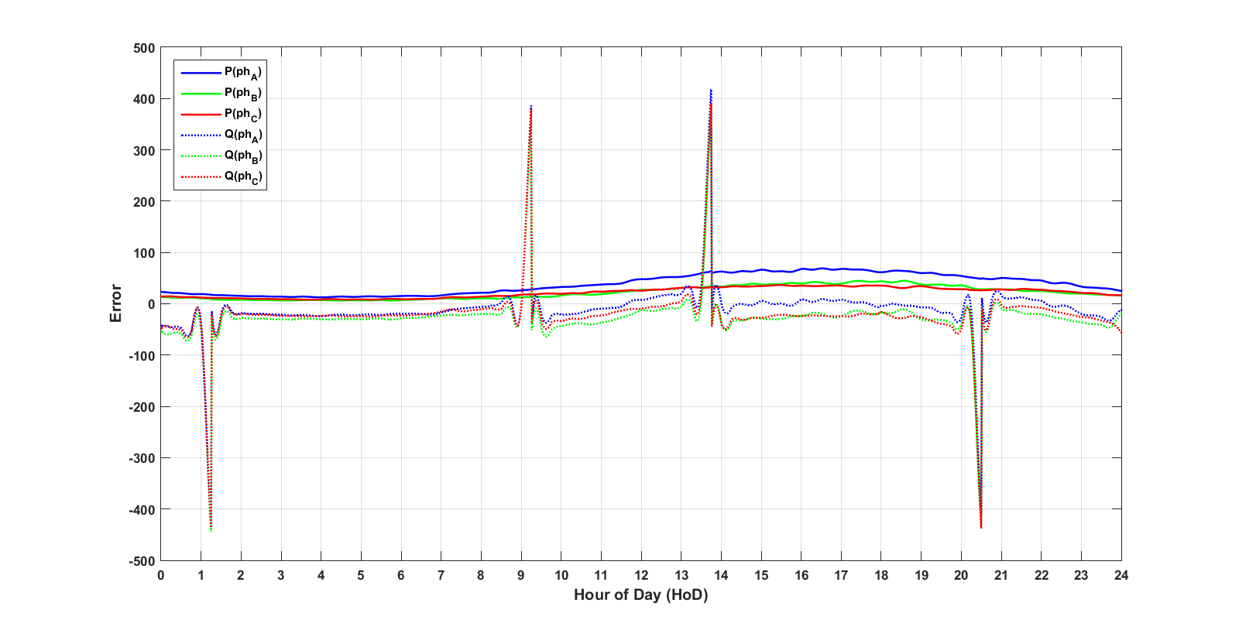
Error

Slide 11
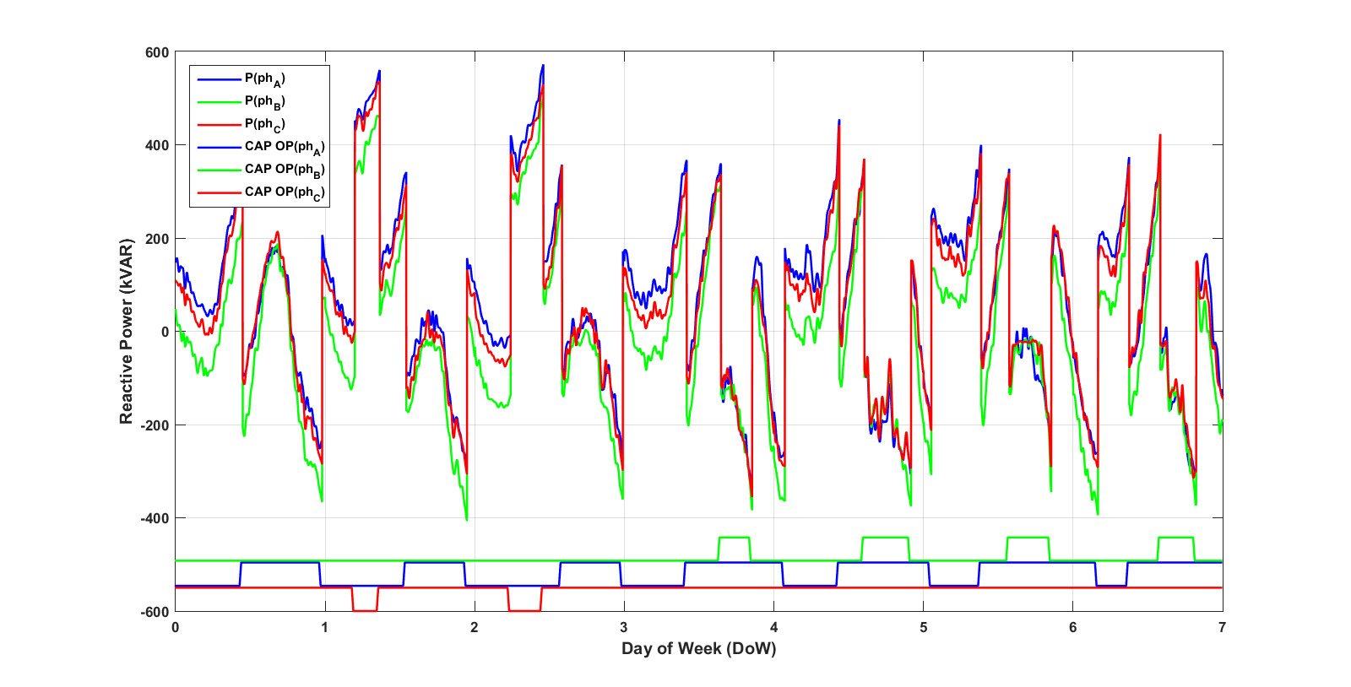
1 Week QSTS

Slide 12
Benefits & Future Work
 | Detailed | Simplified
1 day | 8.29 m | 2.72 s
1 week | 58 m | 19.06 s
1 month | 3.87 h | 1.27 m
1 quarter | 11.6 h | 3.81 m
1 year | 2.09 d | 16.5 m
Time Reduction: 99.45%
Max Real Power Error: 2.22%
Investigate MATLAB control of SVRs using simplified model
Automatic simplified model generation through collapse of nodes and loads

